Slide 1
BANK CUSTOMER QUEUE MANAGEMENT SYSTEM

Slide 2
INTRODUCTION
Managing customer efficiently is a crucial task in banking operations.
To simulate and practice queue management we developed a program that implements a customer queue system using the C programming language.
The system uses a linked list that dynamically manage customers entering and leaving the queue.

Slide 3
OBJECTIVE
To implement a queue data structure using linked lists in C.
To manage th real-time addition (enqueue) and removal (dequeue) of customers.
To display the queue status at any point .
To understand dynamic memory management (malloc,free) in C.
To simulate real-world queue handling in banks.

Slide 4
WHY C AND DSA
C language is powerful ,close to hardware, and provides direct memory control,making it perfect for understanding how queues are managed internally.
Data structures like linked list provide efficient ways to handle dynamic datasets without fixed memory size limitations.
Algorithms help efficiently perform operations (enqueue,dequeue,display) in optimal time (O(1) for enqueue and dequeue).
Learning C and DSA together strengthens the ability to solve real-world problems systematically.

Slide 5
ALGORITHM
1.ENQUEUE (Adding a customer):
Create a new node with customer’s name.
If the queue is empty then set front and rear to the new node.
Else link the new node at the end and update rear.
2.DEQUEUE ( serving the customer):
Check if the queue is empty .if yes display a message.
Else ,remove the front node and update front node to the next node.
If after dequeue the queue becomes empty ,set rear to NULL.
3.DISPLAY QUEUE:
Traverse from font to rear , printing each customer’s name.

Slide 6
LESSONS LEARNT
How to implement and manipulate a linked list.
How queues world in real-world scenarios (FIFO: first in ,first out).
Importance of dynamic memory allocation and avoiding memory leaks.
Handling edge cases (like empty queue situations).
Writing modular and readable code in C.
Better understanding of algorithmic thinking and data management.

Slide 7
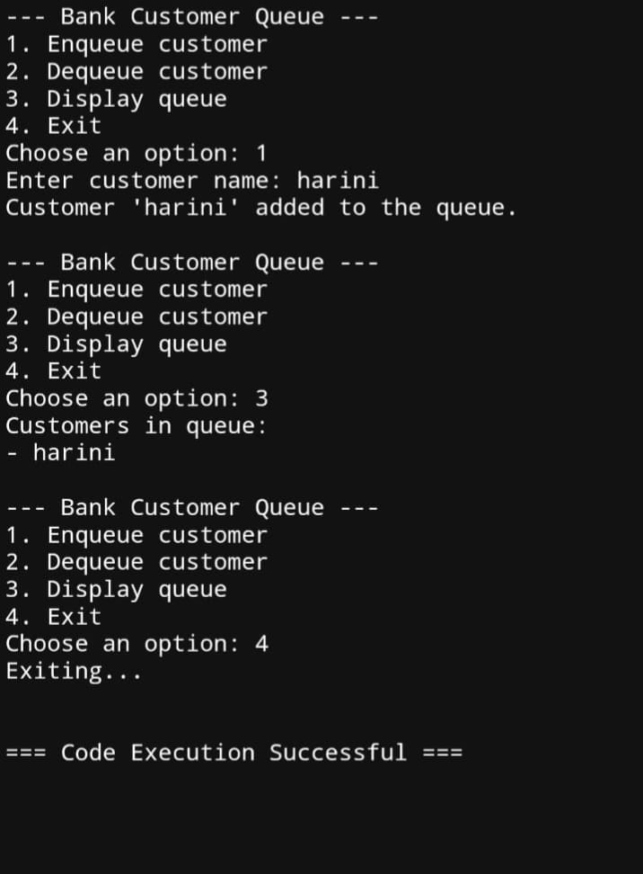

output

Slide 8
THANK YOU
Presented by:
S. Harini
G. Nandini
K. Rakshitha

